Slide 1
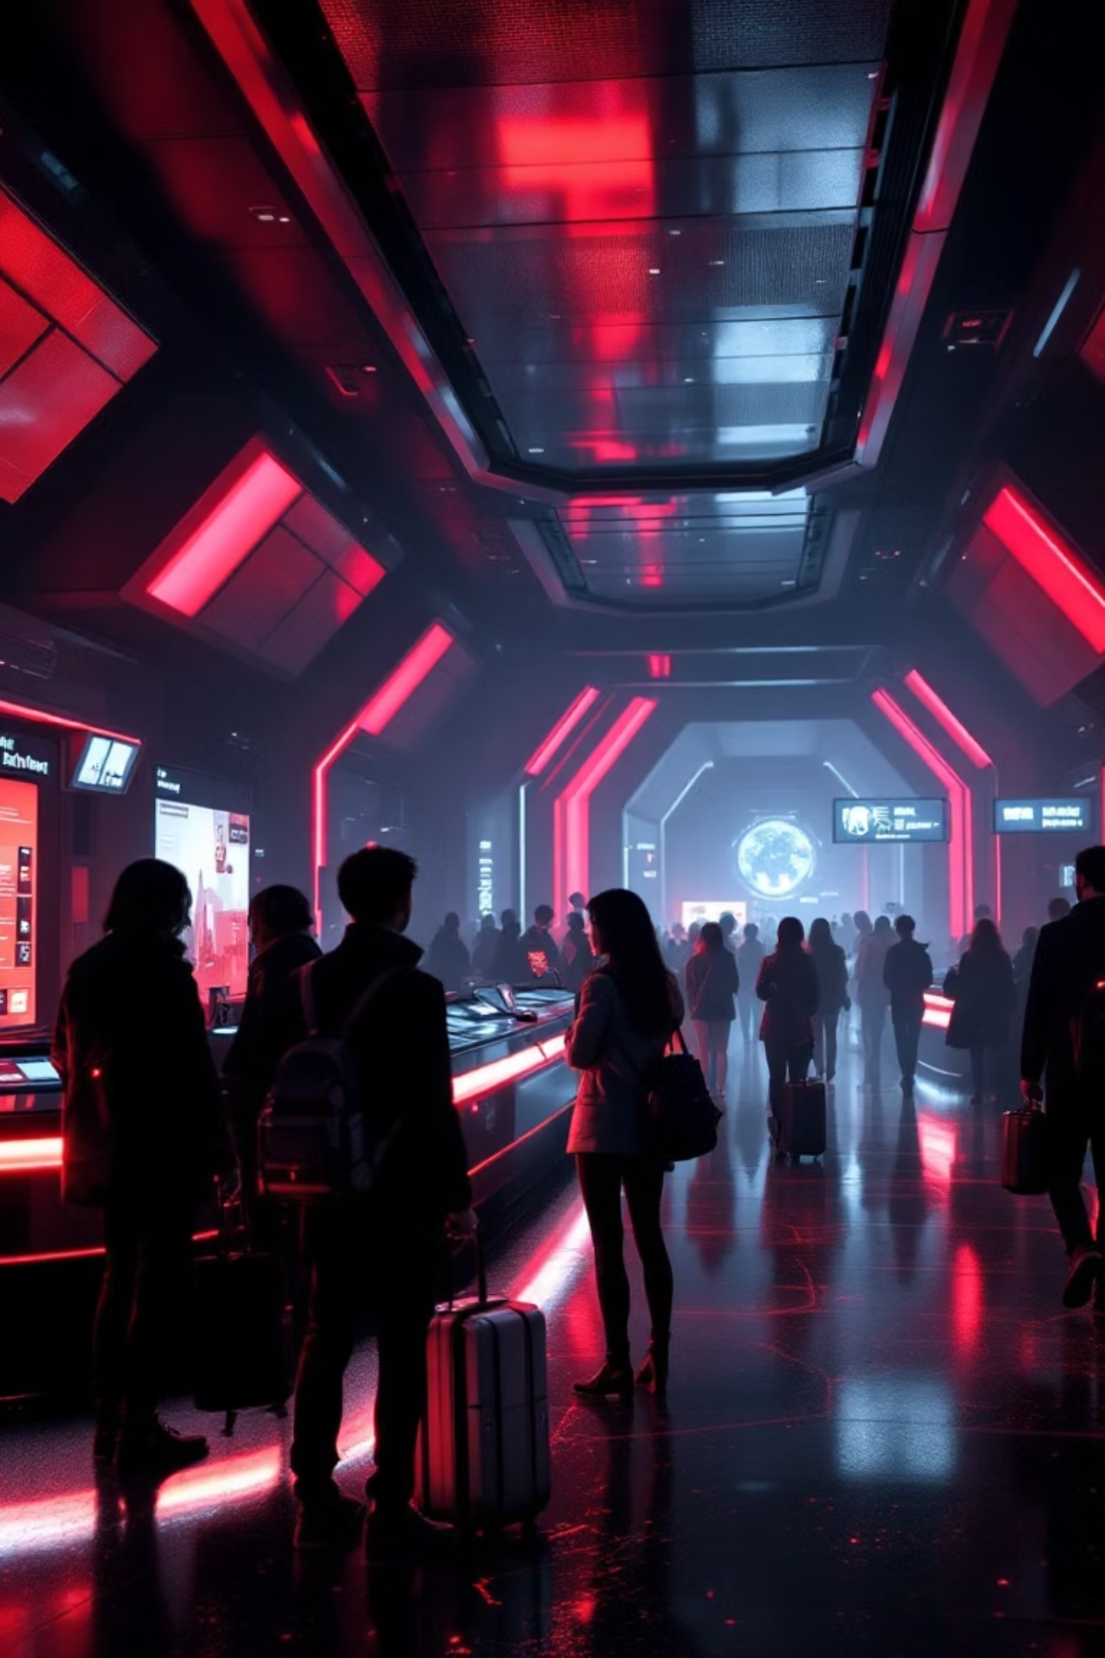
AI in Travel & Tourism: Revolutionising Experiences
The travel and tourism sector is undergoing a profound transformation, powered by advancements in data analytics, artificial intelligence (AI), and the Internet of Things (IoT).
N Vinod Kumar
24MBMA67

Slide 2
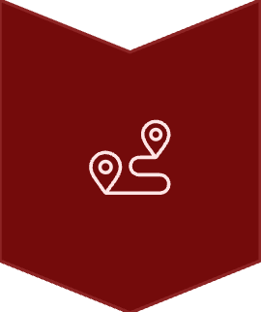




Key Pillars of AI Transformation
Route Optimisation
Intelligent routing for efficiency and customer satisfaction.
Smart Ticket Pricing
Dynamic fare adjustments for revenue maximisation.
Passenger Prediction
Optimising public transport resource allocation.
Autonomous Navigation
Enhancing safety and traveller assistance.
Safety & Accident Analysis
Proactive risk detection and prevention.

Slide 3
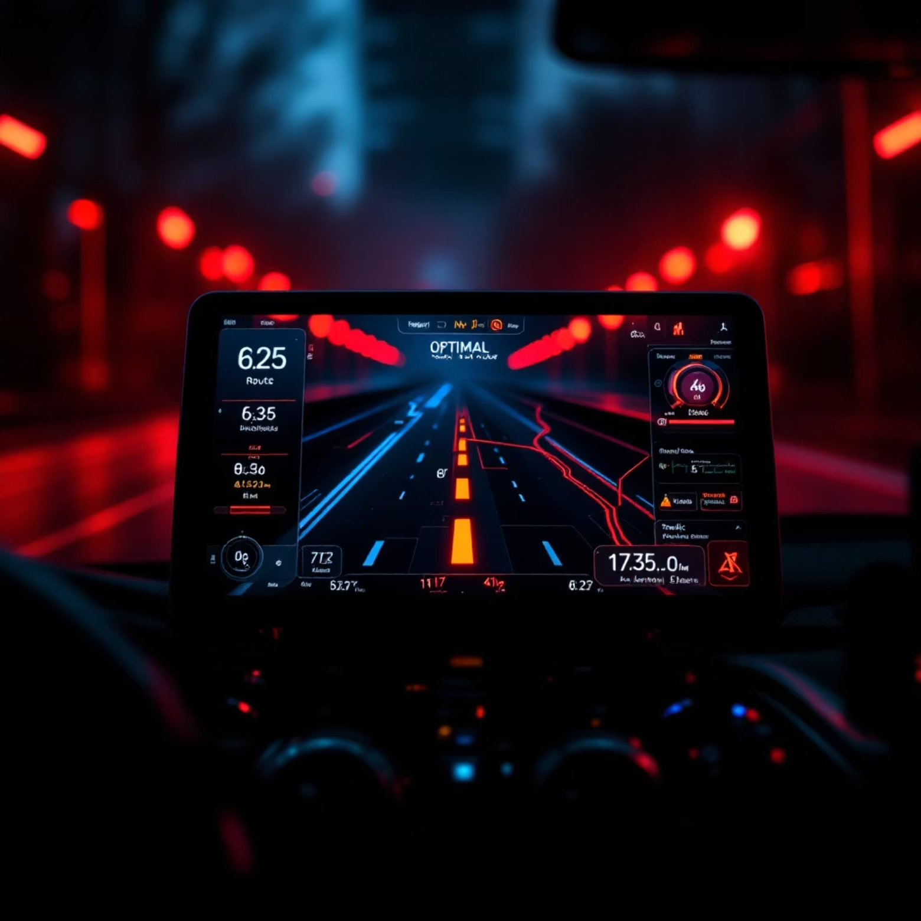
Use Case 1: Route Optimisation System
Route optimisation is a critical process involving the identification of the most efficient travel paths. It leverages comprehensive data encompassing distance, real-time traffic conditions, weather forecasts, and operational costs to determine optimal routes.
Key Objectives:
Minimise travel duration and fuel consumption for all vehicles.
Improve the utilisation of vehicle fleets and scheduling accuracy.
Elevate customer satisfaction through prompt and dependable services.
Technologies Used:
Dijkstra's Algorithm & A* Search for pathfinding.
Genetic Algorithms for complex route scenarios.
Machine Learning (Reinforcement Learning) for dynamic adjustments.
Applications span travel agencies, logistics, ride-sharing services, and public transport, leading to reduced operational costs and enhanced reliability.

Slide 4
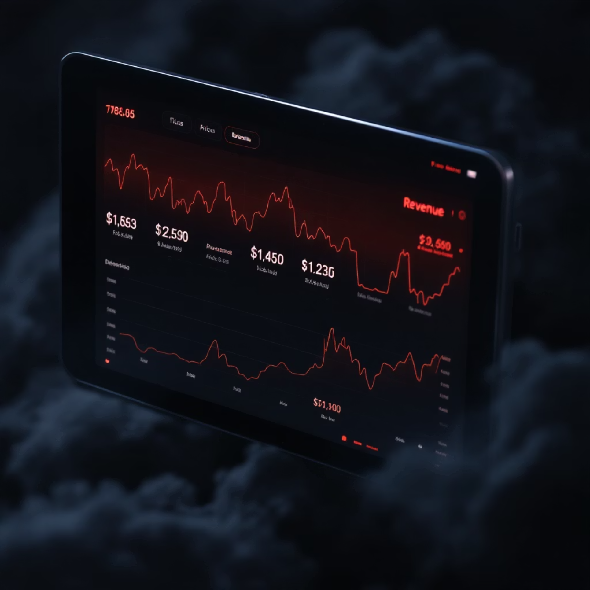
Use Case 2: Smart Ticket Pricing System
Overview:
AI-driven ticket pricing dynamically adjusts fares based on real-time demand, seasonal variations, booking patterns, and competitor pricing, ensuring optimal revenue generation and customer value.
Objectives:
Maximise revenue for travel operators and agencies.
Deliver competitive and equitable pricing to customers.
Effectively balance market supply and demand.
Data & Algorithms:
Historical sales & seasonal trends data.
Machine Learning Regression Models for predictions.
ARIMA/SARIMA for time-series forecasting.
Reinforcement Learning for adaptive pricing strategies.
This system has proven beneficial for airlines, railways, bus services, hotel booking platforms, and event ticketing, resulting in increased profitability and improved customer loyalty.

Slide 5
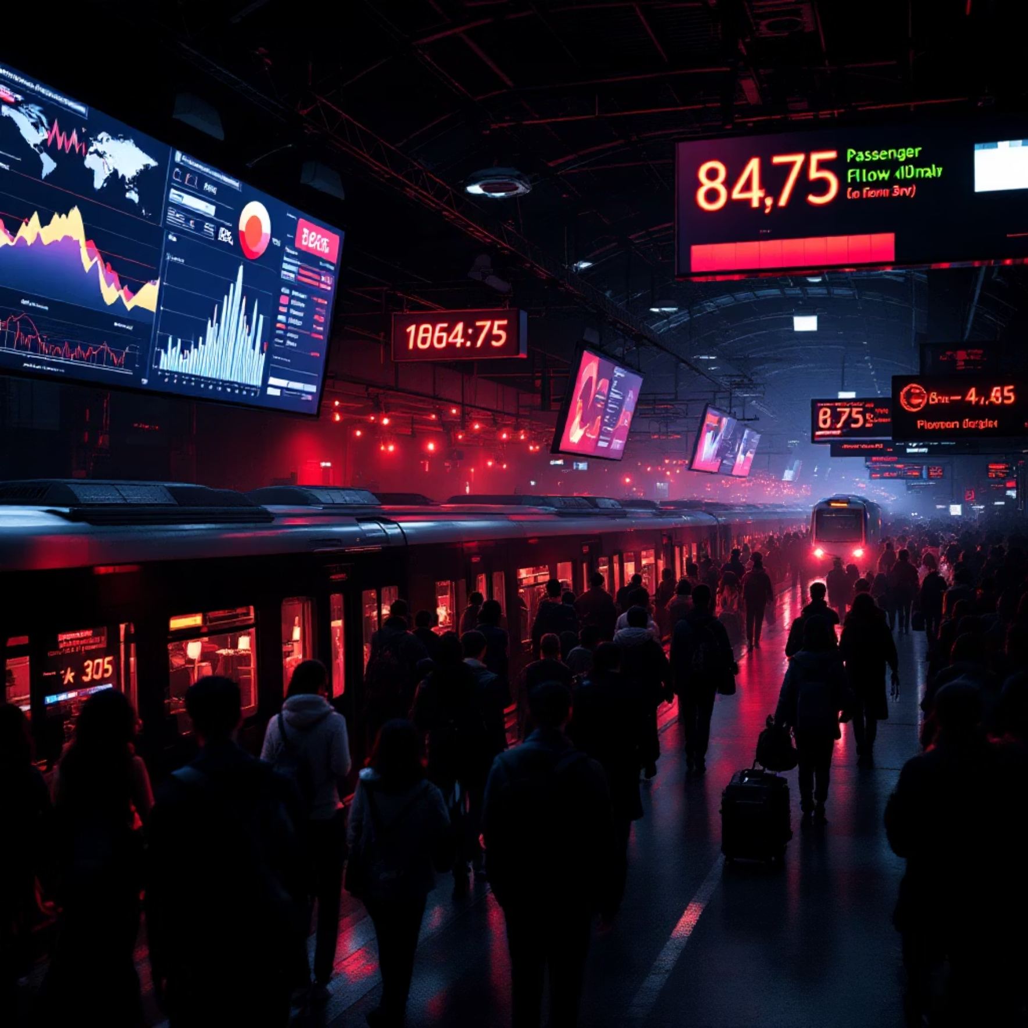
Use Case 3: Passenger Prediction in Public Transport
Predicting passenger volumes is crucial for optimising public transport services. This system aids in fine-tuning vehicle frequency, resource allocation, and effectively mitigating congestion, thereby improving urban mobility.
Objectives:
Streamline transport planning and scheduling.
Minimise overcrowding and reduce passenger waiting times.
Enhance overall passenger experience and operational efficiency.
Key Technologies:
Regression Models (Linear, Random Forest, XGBoost) for accurate forecasting.
Deep Learning (LSTM, RNN) for advanced time-series analysis.
Clustering techniques for identifying travel pattern segments.
This system is vital for metros, buses, trains, and airports, as well as for tourism cities managing seasonal rushes. Benefits include efficient transport management, reduced operational costs, and improved passenger satisfaction.

Slide 6
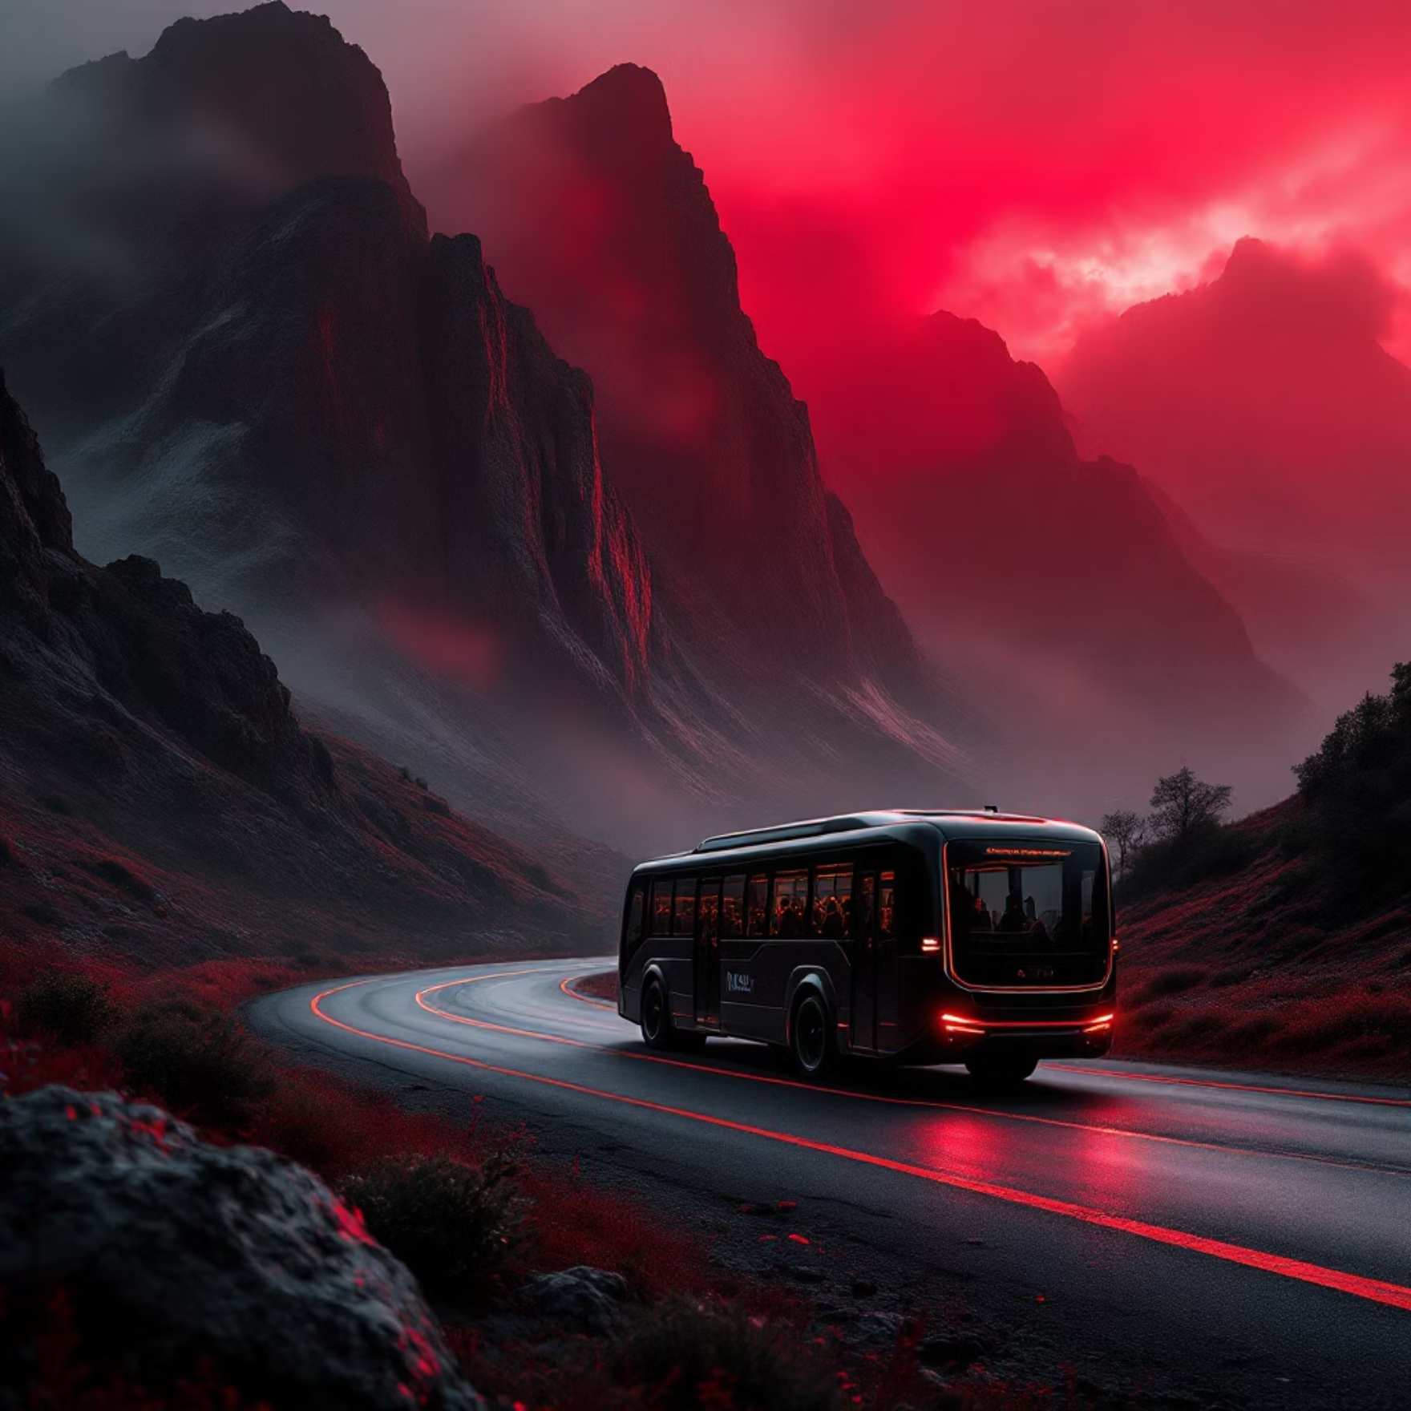
Use Case 4: Automatic Vehicle Navigation
AI-based automatic vehicle navigation systems autonomously guide vehicles using integrated GPS, sensor data, and advanced mapping. This technology is revolutionising how we travel and explore new destinations.
Objectives:
Significantly improve road safety and minimise driver fatigue.
Enable the deployment of autonomous and semi-autonomous tourism vehicles.
Provide invaluable assistance to travellers navigating unfamiliar terrains.
Core Algorithms:
Computer Vision for object and lane detection.
Deep Reinforcement Learning for decision-making.
SLAM (Simultaneous Localisation and Mapping) for environmental awareness.
Applications include self-driving tourist buses, smart maps, and robotic guides in various travel hubs, leading to safer, smoother, and more accessible travel experiences.

Slide 7

Use Case 5: Safety and Accident Analysis
This system focuses on predicting and analysing accidents to cultivate safer travel environments. By leveraging vast datasets, it aims to prevent incidents before they occur and improve response mechanisms.
Objectives:
Identify and mitigate risk zones to prevent accidents effectively.
Reduce both human casualties and economic losses from incidents.
Inform policymaking and facilitate infrastructure improvements.
Data & Models:
Historical accident data, road conditions, and traffic flows.
Driver behaviour analysis (speed, fatigue) and environmental factors.
Classification Models (Logistic Regression, Decision Tree) for prediction.
Neural Networks for advanced accident forecasting.
Government transport departments, insurance agencies, and tourism transport management greatly benefit from this, leading to fewer accidents, safer road networks, and enhanced emergency response capabilities.

Slide 8








A Glimpse into the Future of Travel
The integration of AI and data analytics into the travel and tourism sector is fundamentally transforming the industry, driving unparalleled improvements in efficiency, safety, and customer satisfaction.
Sustainable Tourism
Smart City Growth
AI-driven solutions support eco-friendly practices and resource management.
Enhanced urban mobility and seamless integration of transport systems.
Customer-Centric
Innovative Experiences
Meeting evolving traveller needs with precision and care.
Personalised and cutting-edge travel adventures for all.
The future promises further innovations, including AI-driven personalisation, autonomous travel planning, and eco-friendly route recommendations, all contributing to a more intelligent and enjoyable travel landscape.

Slide 9








Tools & Technologies Powering the Future
Programming Languages:
Python: Versatile for AI development and data science.
R: Specialised for statistical computing and graphics.
Frameworks:
TensorFlow & PyTorch: For deep learning and neural network implementations.
Scikit-learn: A comprehensive machine learning library.
Visualisation & Data Sources:
Power BI, Tableau, Matplotlib: For insightful data representation.
Government Transport APIs, GPS Data, Travel Portals: Rich sources for real-time information.

Slide 10


Future Enhancements: The Horizon of Possibilities
IoT Integration for Real-time Monitoring
AI-driven Personalised Travel Recommendations
Blockchain for Secure & Transparent Ticketing
Seamless connectivity with IoT devices will enable live monitoring and responsive adjustments across all travel operations.
Implementing blockchain technology to ensure unparalleled security and transparency in ticketing and booking systems.
Leveraging AI to curate bespoke travel experiences, tailored to individual preferences and historical data.
These enhancements promise to further revolutionise the travel industry, making journeys smarter, safer, and more personalised for every traveller.

